Slide 1
Legislative Update and Forecast Stephanie Czuhajewski, MPH, CAE ADA Executive Director

Slide 2
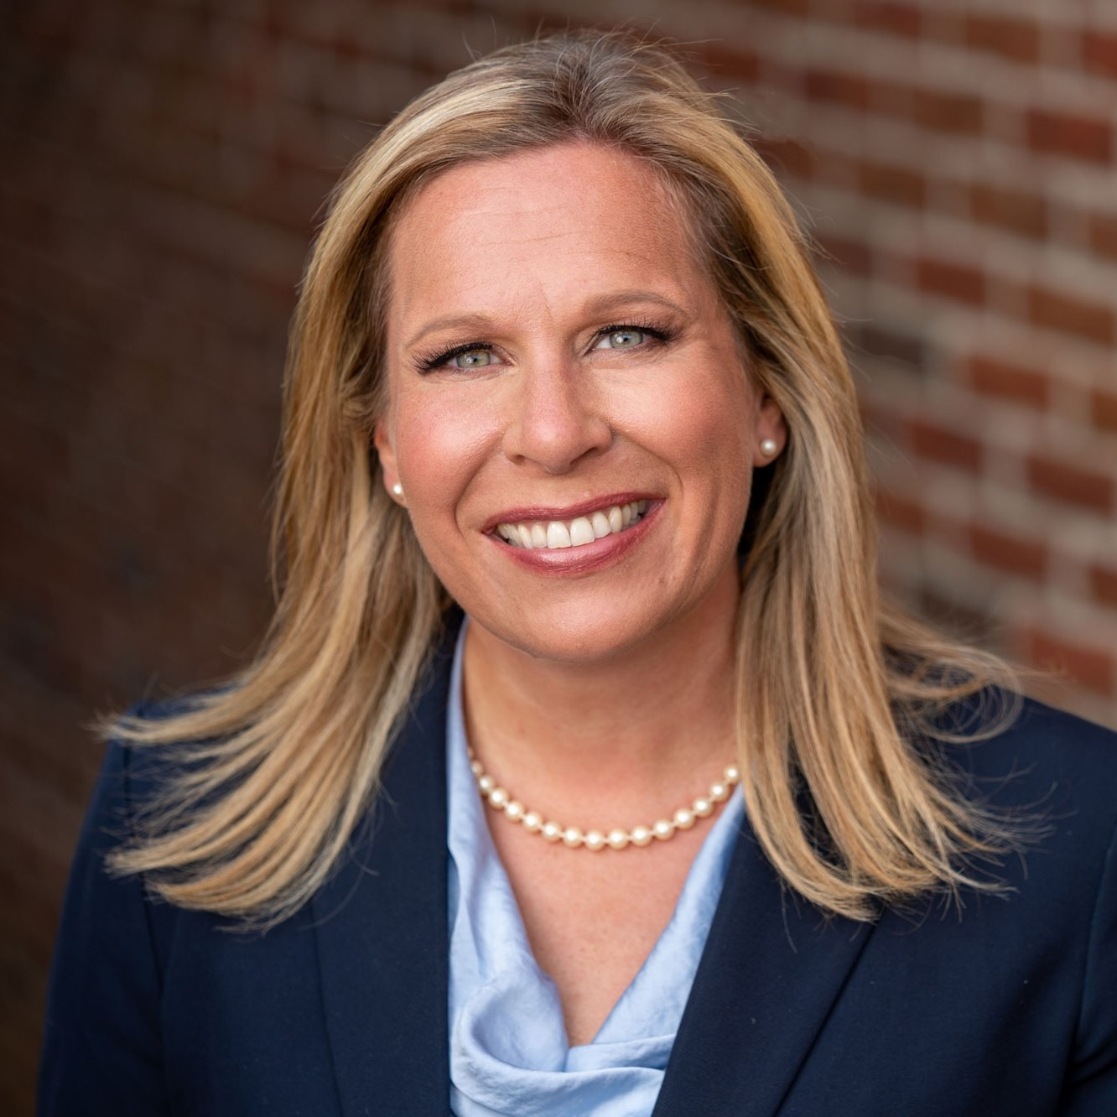
Kentucky Senator Amanda Mays Bledsoe

Slide 3
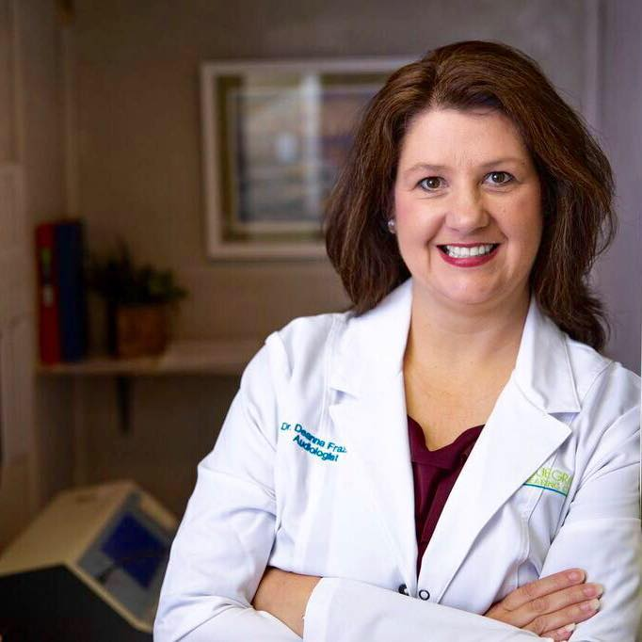
Kentucky Representative Deanna Frazier Gordon, Au.D.

Slide 4
Federal Issue Update

Slide 5
Federal Policy Issues
Implementation of CMS Limited Direct Access and Modifier
CMS 2024 Medicare Physician Fee Schedule
Medicare Advantage/Managed Care Concerns

Slide 6
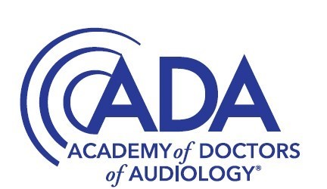
AND CMS WILL ENSURE SEAMLESS IMPLEMENTATION AND TRANSPARENCY, RIGHT?
CMS: WE HAVE CREATED A NEW REGULATION THAT WILL ALLOW CERTAIN PART B BENEFICIARIES TO COME DIRECTLY TO THE AUDIOLOGIST FOR “NON-ACUTE” HEARING PROBLEMS
AND CMS WILL ENSURE SEAMLESS IMPLEMENTATION AND TRANSPARENCY… RIGHT?

Slide 7
Medicare Audiology Access Improvement Act (S. 2377)
Direct Access
Reimbursement for Medicare-covered services within an audiologist’s scope of practice
Practitioner classification under Medicare

Slide 8
State Issues

Slide 9
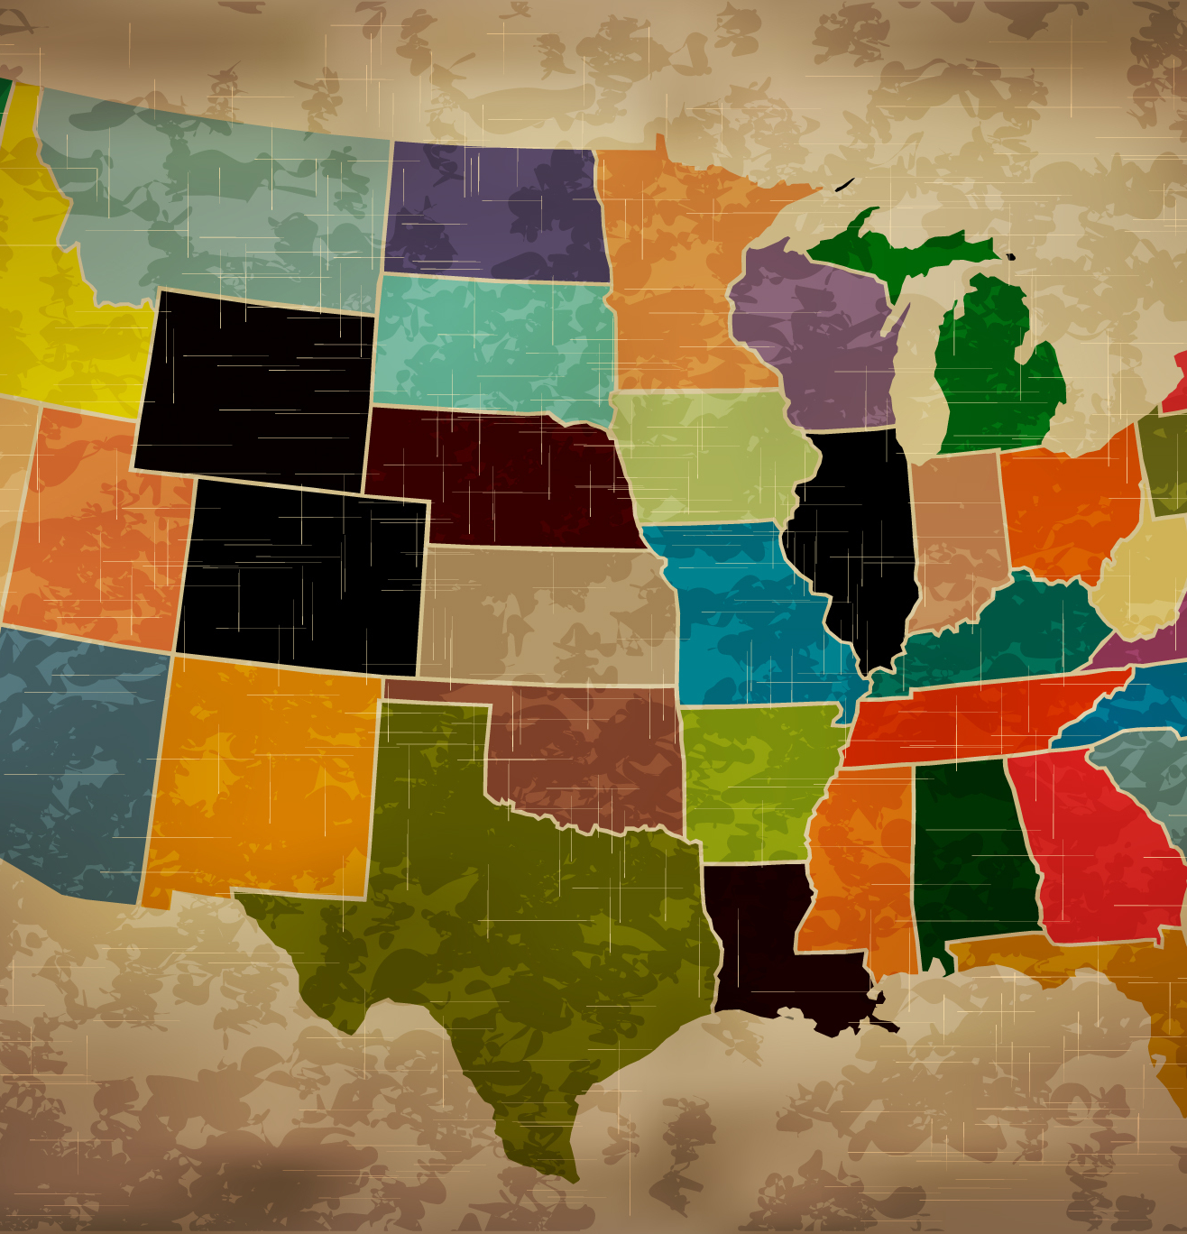
State Issues
Interstate Compact
OTC Hearing Aids
Dispensing Prescription Hearing Aids

Slide 10
A-SLP Interstate Compact Map

Slide 11
FDA OTC Hearing Aid Regulation
Implemented on October 17, 2022
Created new categories for OTC and prescription hearing aids.

Slide 12
THE FDA
STATE LAWS RELATED TO PRESCRIPTION HEARING AIDS

Slide 13
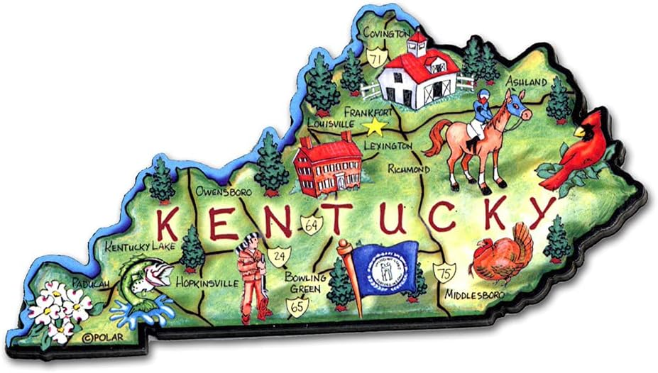
Kentucky OTC/Prescription HA Legislation
SB 58, introduced by Sen. Amanda Mays Bledsoe
Updated KY statute to align with FDA regs and ensured continued consumer access to “prescription” hearing aids
Kentucky became one of the first 2 states to effectively address this issue

Slide 14
Legislative Update and Forecast

